Slide 1

CHAPTER 1
SPEAKING MATHEMATICALLY
Copyright © Cengage Learning. All rights reserved.

Slide 2

1.2
The Language of Sets
Copyright © Cengage Learning. All rights reserved.

Slide 3
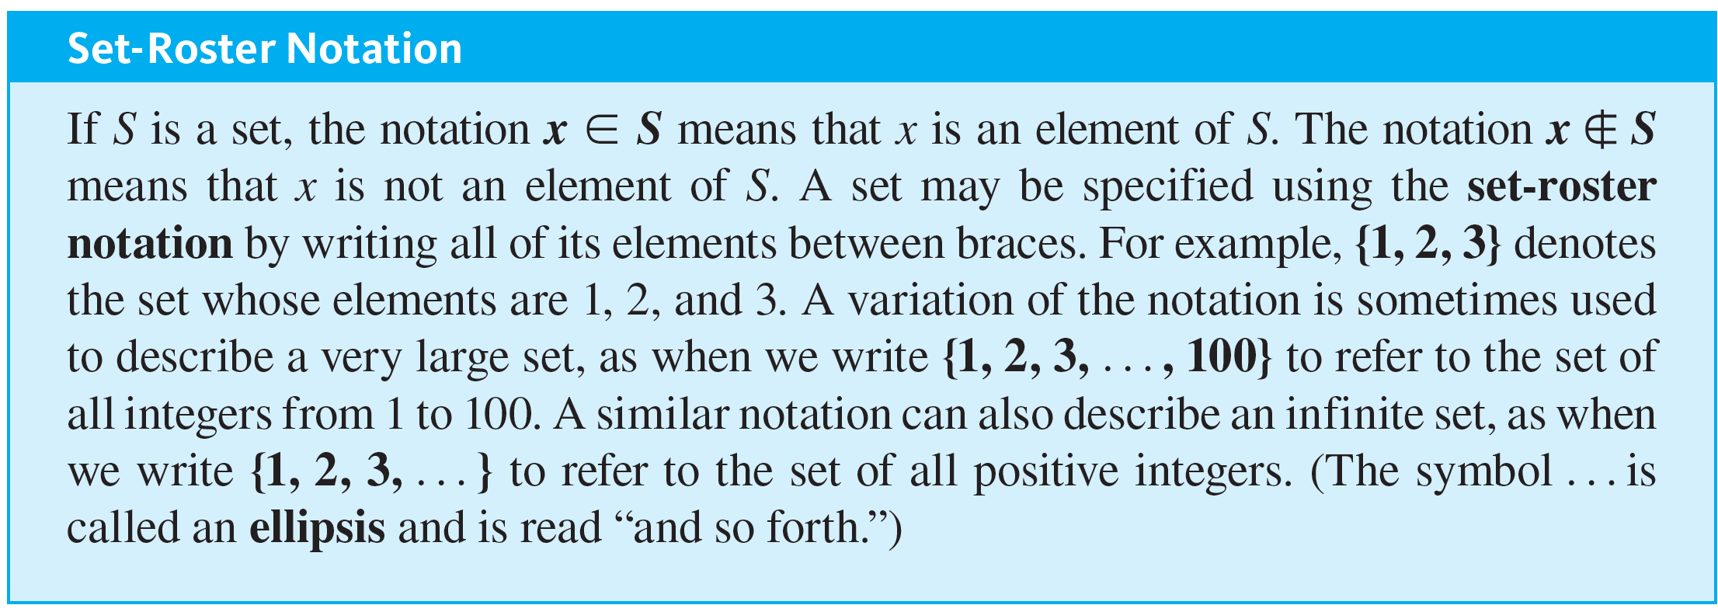
The Language of Sets
Use of the word set as a formal mathematical term was introduced in 1879 by Georg Cantor (1845–1918). For most mathematical purposes we can think of a set intuitively, as Cantor did, simply as a collection of elements.

Slide 4
The Language of Sets
The axiom of extension says that a set is completely determined by what its elements are—not the order in which they might be listed or the fact that some elements might be listed more than once.

Slide 5
Example 1.2.1 – Using the Set-Roster Notation
a. Let A = {1, 2, 3}, B = {3, 1, 2}, and C = {1, 1, 2, 3, 3, 3}. What are the elements of A, B, and C? How are A, B, and C related?
b. Is {0} = 0?
c. How many elements are in the set {1, {1}}?
d. For each nonnegative integer n, let ∪_{n} = {n, −n}. Find ∪₁, ∪₂, and ∪₀.

Slide 6
Example 1.2.1 – Solution
a. A, B, and C have exactly the same three elements: 1, 2, and 3. Therefore, A, B, and C are simply different ways to represent the same set.
b. {0} ≠ 0 because {0} is a set with one element, namely 0, whereas 0 is just the symbol that represents the number zero.

Slide 7
Example 1.2.1 – Solution
continued
c. The set {1, {1}} has two elements: 1 and the set whose only element is 1.
d. ∪₁ = {1, −1}, ∪₂ = {2, −2}, ∪₀ = {0, −0} = {0, 0} = {0}.

Slide 8
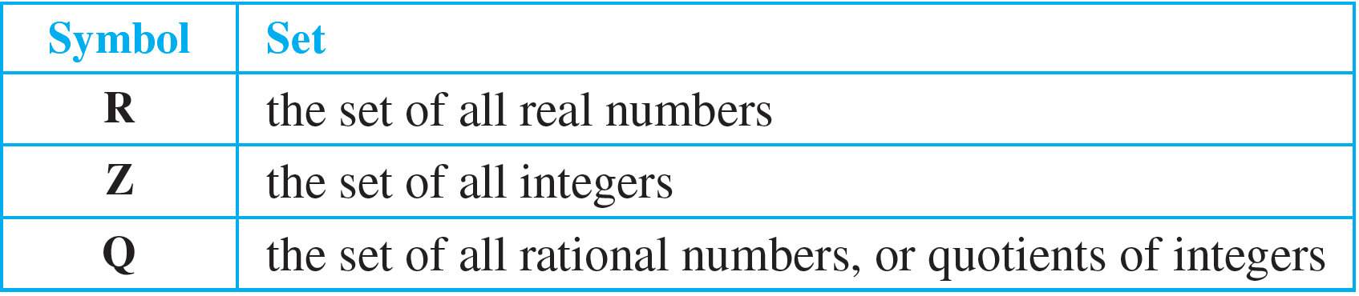
The Language of Sets
Certain sets of numbers are so frequently referred to that they are given special symbolic names. These are summarized in the following table.

Slide 9


The Language of Sets
Addition of a superscript + or − or the letters nonneg indicates that only the positive or negative or nonnegative elements of the set, respectively, are to be included. Thus
denotes the set of positive real numbers, and
refers to the set of nonnegative integers: 0, 1, 2, 3, 4, and so forth.
Some authors refer to the set of nonnegative integers as the set of natural numbers and denote it as N.

Slide 10
The Language of Sets
The set of real numbers is usually pictured as the set of all points on a line. The number 0 corresponds to a middle point, called the origin.
A unit of distance is marked off, and each point to the right of the origin corresponds to a positive real number found by computing its distance from the origin.

Slide 11
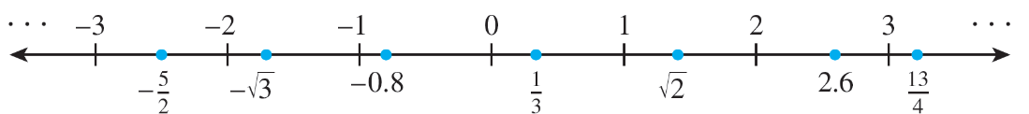
The Language of Sets
Each point to the left of the origin corresponds to a negative real number, which is denoted by computing its distance from the origin and putting a minus sign in front of the resulting number. The set of real numbers is therefore divided into three parts: the set of positive real numbers, the set of negative real numbers, and the number 0. Note that 0 is neither positive nor negative. Labels are given for a few real numbers corresponding to points on the line shown below.

Slide 12
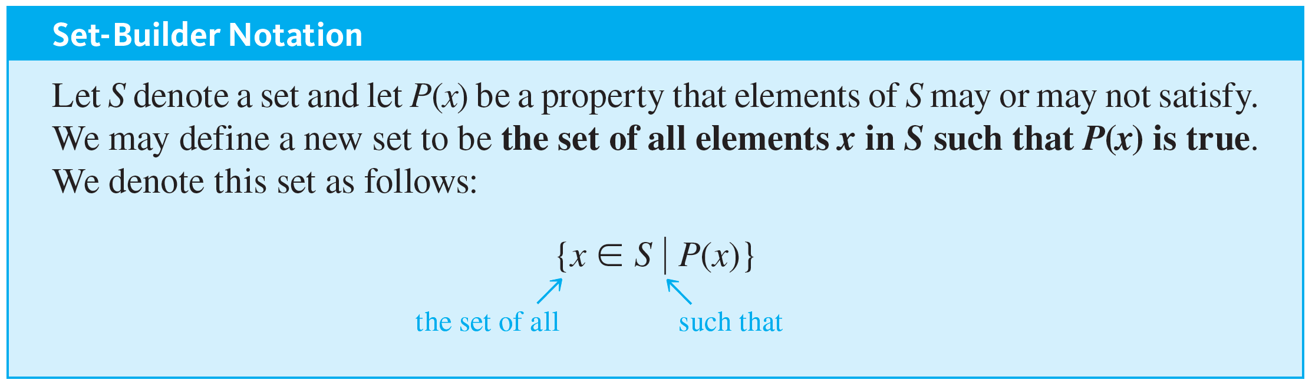
The Language of Sets

Slide 13

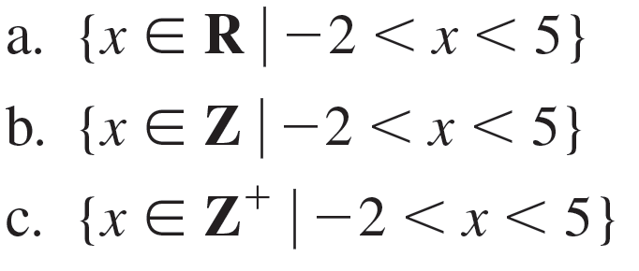
Example 1.2.2 – Using the Set-Builder Notation
Given that R denotes the set of all real numbers, Z the set of all integers, and
the set of all positive integers, describe each of the following sets.

Slide 14
Example 1.2.2 – Solution
is the open interval of real numbers (strictly) between −2 and 5. It is pictured as follows:
is the set of all integers (strictly) between −2 and 5. It is equal to the set {−1, 0, 1, 2, 3, 4}.
c. Since all the integers in
are positive,

Slide 15
Subsets

Slide 16
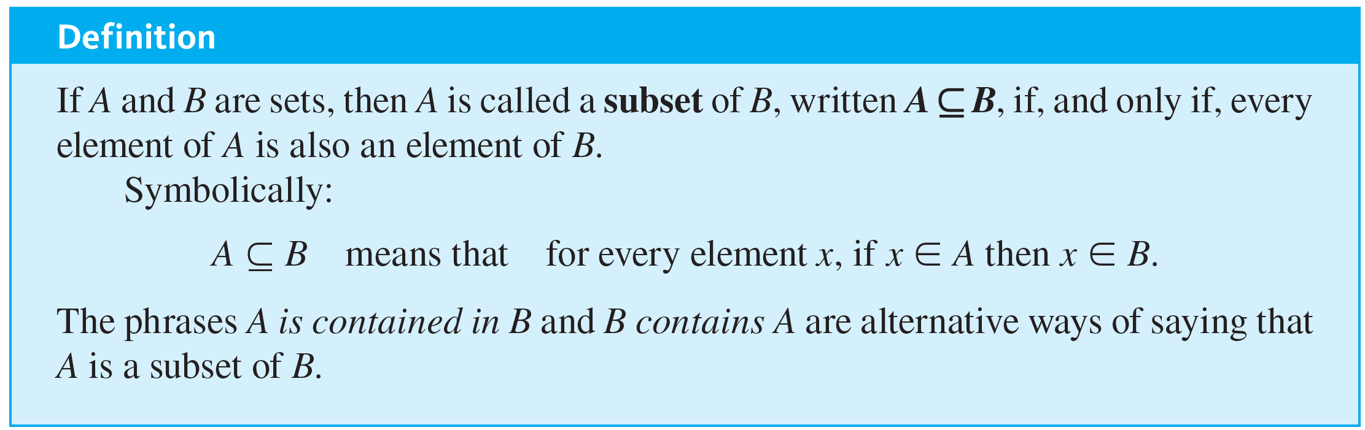
Subsets
A basic relation between sets is that of subset.

Slide 17
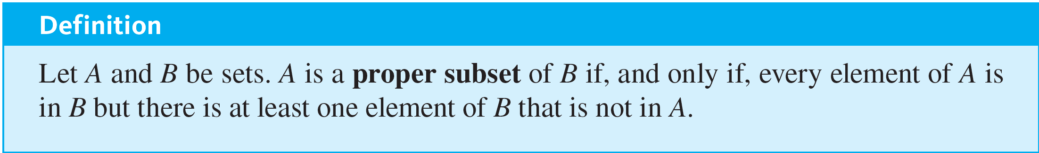
Subsets
It follows from the definition of subset that for a set A not to be a subset of a set B means that there is at least one element of A that is not an element of B. Symbolically:

Slide 18
Example 1.2.3 – Subsets
and C = {100, 200, 300, 400, 500}. Evaluate the truth and falsity of each of the following statements.
a. B ⊆ A
b. C is a proper subset of A
c. C and B have at least one element in common
d. C ⊆ B
e. C ⊆ C
Let

Slide 19
Example 1.2.3 – Solution
a. False. Zero is not a positive integer. Thus zero is in B but zero is not in A, and so B ⊈ A.
b. True. Each element in C is a positive integer and, hence, is in A, but there are elements in A that are not in C. For instance, 1 is in A and not in C.
c. True. For example, 100 is in both C and B.

Slide 20
Example 1.2.3 – Solution
continued
d. False. For example, 200 is in C but not in B.
e. True. Every element in C is in C. In general, the definition of subset implies that all sets are subsets of themselves.

Slide 21
Example 1.2.4 – Distinction between ∈ and ⊆
Which of the following are true statements?
a. 2 ∈ {1, 2, 3}
b. {2} ∈ {1, 2, 3}
c. 2 ⊆ {1, 2, 3}
d. {2} ⊆ {1, 2, 3}
e. {2} ⊆ {{1}, {2}}
f. {2} ∈ {{1}, {2}}

Slide 22
Example 1.2.4 – Solution
Only (a), (d), and (f) are true.
For (b) to be true, the set {1, 2, 3} would have to contain the element {2}. But the only elements of {1, 2, 3} are 1, 2, and 3, and 2 is not equal to {2}. Hence (b) is false.
For (c) to be true, the number 2 would have to be a set and every element in the set 2 would have to be an element of {1, 2, 3}. This is not the case, so (c) is false.

Slide 23
Example 1.2.4 – Solution
continued
For (e) to be true, every element in the set containing only the number 2 would have to be an element of the set whose elements are {1} and {2}. But 2 is not equal to either {1} or {2}, and so (e) is false.

Slide 24
Cartesian Products

Slide 25
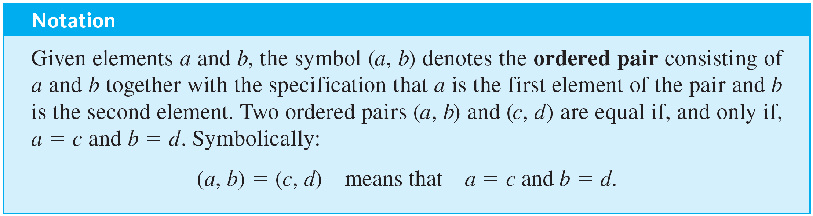
Cartesian Products

Slide 26
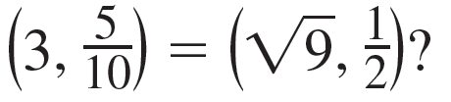
Example 1.2.5 – Ordered Pairs
a. Is (1, 2) = (2, 1)?
b. Is
c. What is the first element of (1, 1)?

Slide 27
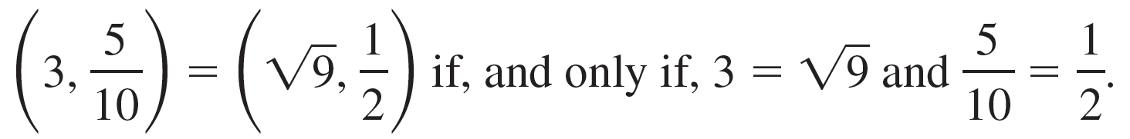
Example 1.2.5 – Solution
a. No. By definition of equality of ordered pairs,
(1, 2) = (2, 1) if, and only if, 1 = 2 and 2 = 1.
But 1 ≠ 2, and so the ordered pairs are not equal.
b. Yes. By definition of equality of ordered pairs,
Because these equations are both true, the ordered pairs are equal.

Slide 28
Example 1.2.5 – Solution
continued
c. In the ordered pair (1, 1), the first and the second elements are both 1.

Slide 29
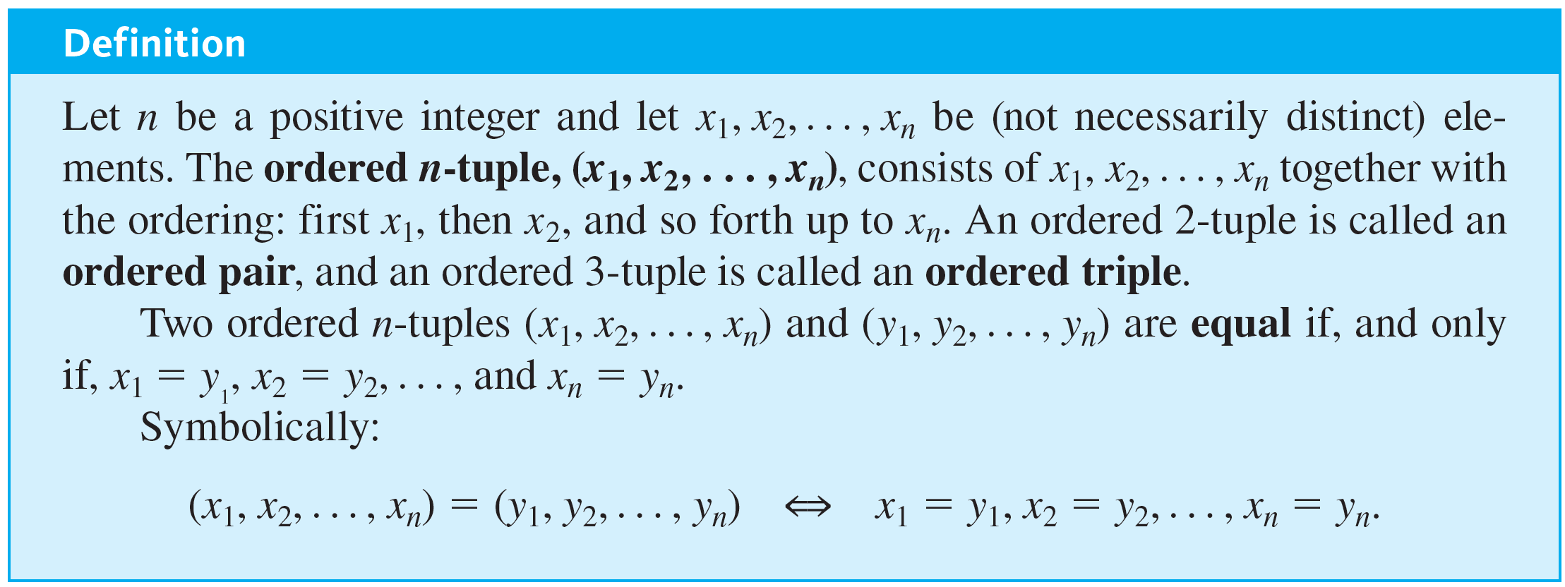
Cartesian Products
The notation for an ordered n-tuple generalizes the notation for an ordered pair to a set with any finite number of elements. It also takes both order and multiplicity into account.

Slide 30
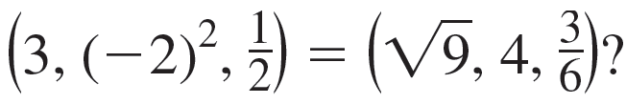
Example 1.2.6 – Ordered n-tuples
a. Is (1, 2, 3, 4) = (1, 2, 4, 3)?
b. Is

Slide 31
Example 1.2.6 – Solution
a. No. By definition of equality of ordered 4-tuples,
But 3 ≠ 4, and so the ordered 4-tuples are not equal.

Slide 32
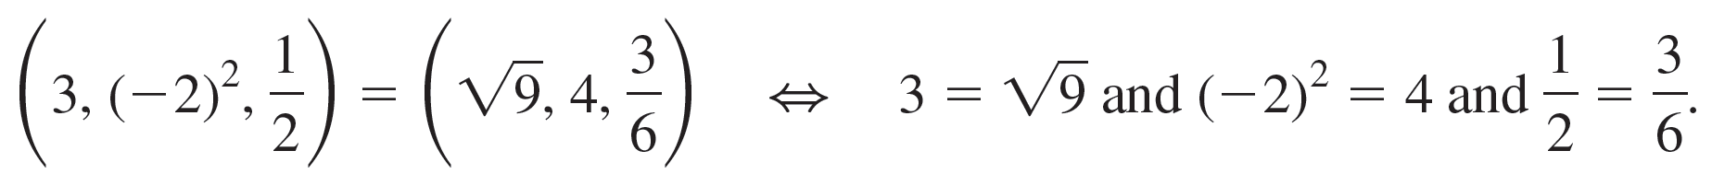
Example 1.2.6 – Solution
continued
b. Yes. By definition of equality of ordered triples,
Because these equations are all true, the two ordered triples are equal.

Slide 33
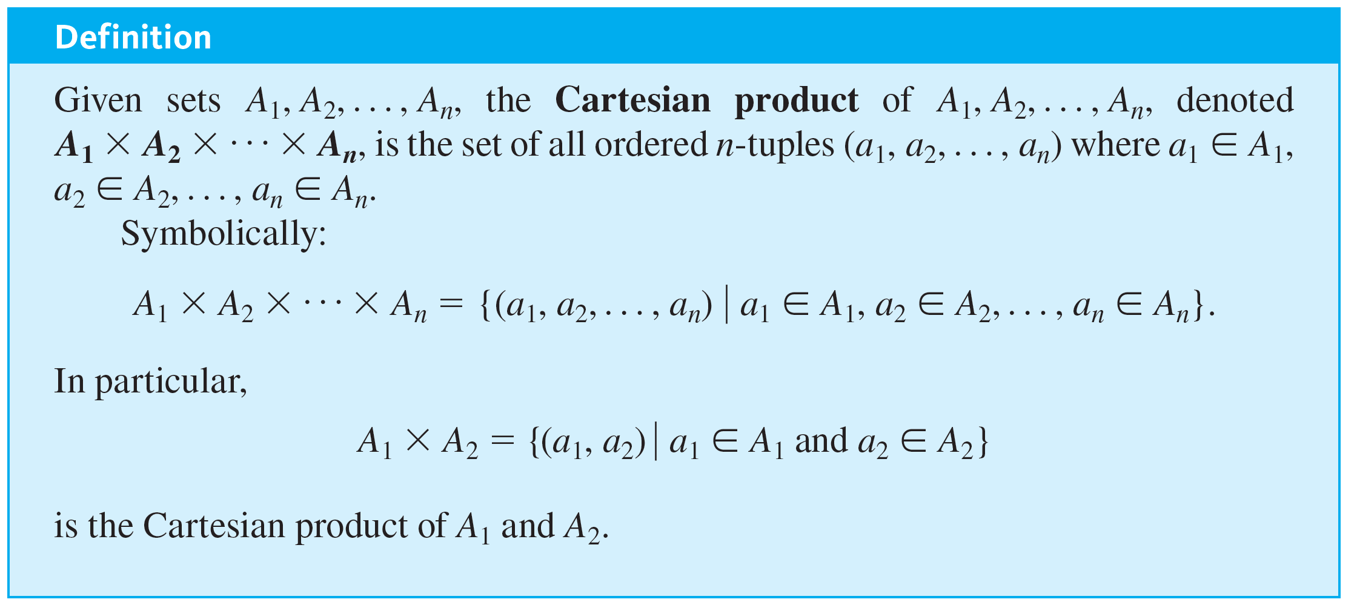
Cartesian Products

Slide 34
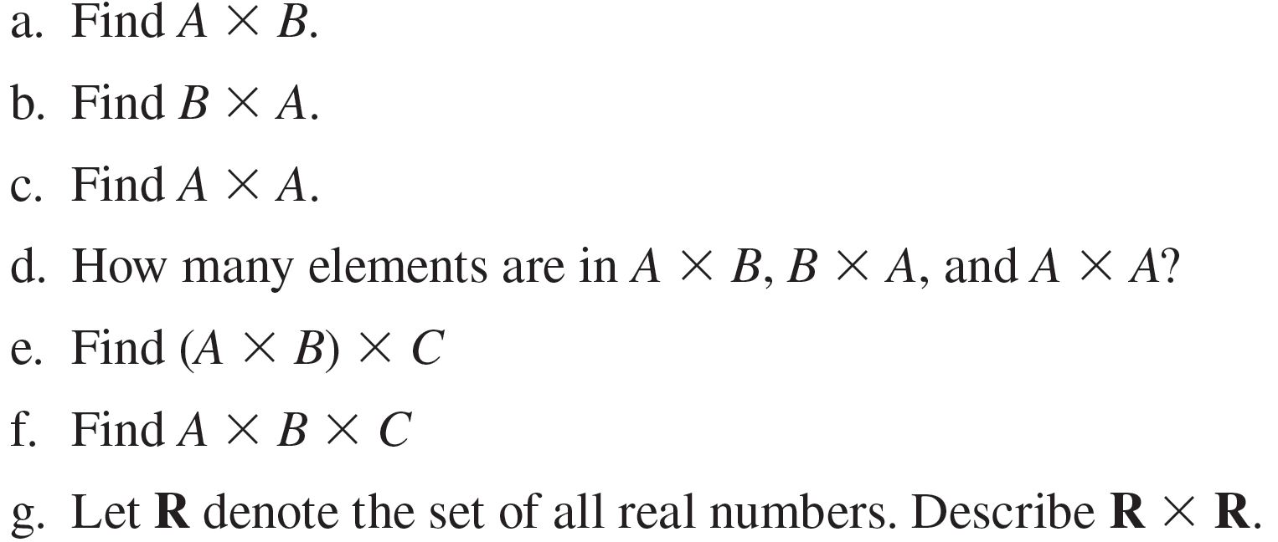
Example 1.2.7 – Cartesian Products
Let A = {x, y}, B = {1, 2, 3}, and C = {a, b}.

Slide 35
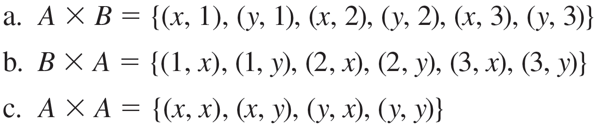



Example 1.2.7 – Solution
has 6 elements. Note that this is the number of elements in A times the number of elements in B.
has 6 elements, the number of elements in B times the number of elements in A.
has 4 elements, the number of elements in A times the number of elements in A.

Slide 36

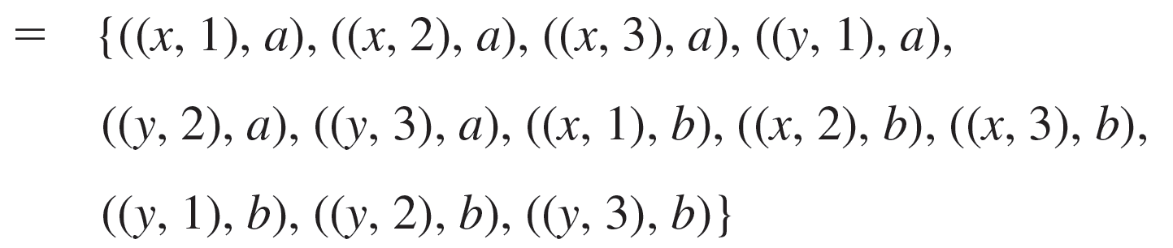
Example 1.2.7 – Solution
continued
e. The Cartesian product of A and B is a set, so it may be used as one of the sets making up another Cartesian product. This is the case for

Slide 37



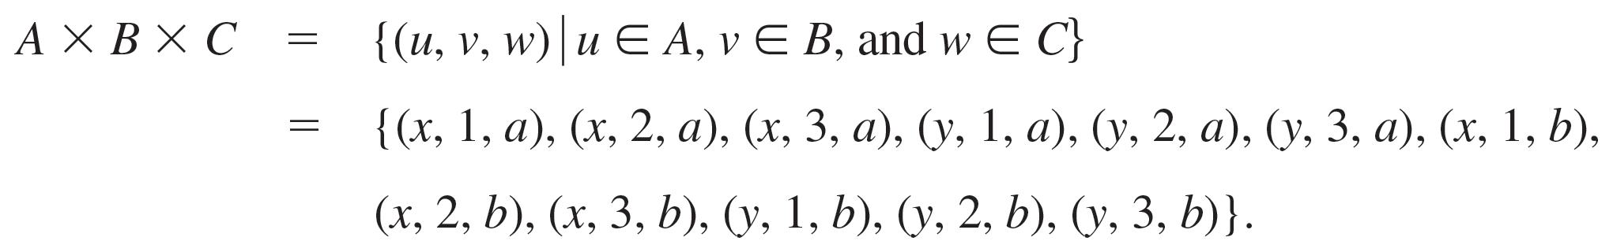
Example 1.2.7 – Solution
continued
is superficially similar to but is not quite the same mathematical object as
f. The Cartesian product
is a set of ordered pairs of which one element is itself an ordered pair, whereas
is a set of ordered triples. By definition of Cartesian product,

Slide 38


Example 1.2.7 – Solution
continued
is the set of all ordered pairs (x, y) where both x and y are real numbers. If horizontal and vertical axes are drawn on a plane and a unit length is marked off, then each ordered pair in
corresponds to a unique point in the plane, with the first and second elements of the pair indicating, respectively, the horizontal and vertical positions of the point.

Slide 39
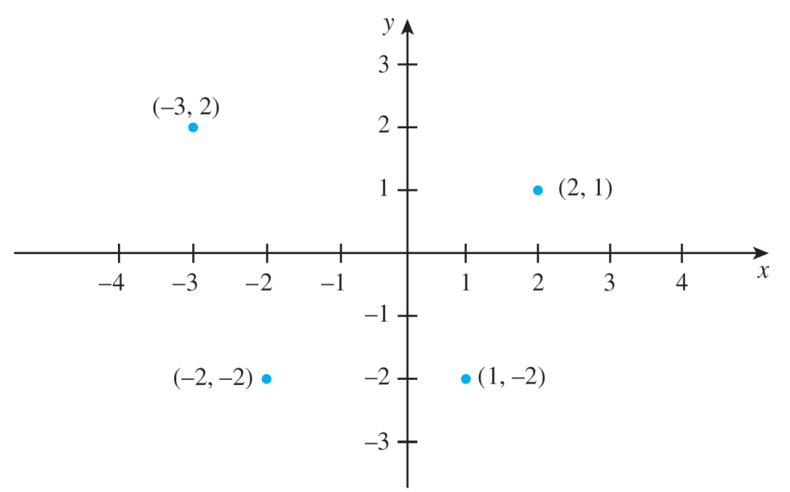
Example 1.2.7 – Solution
continued
The term Cartesian plane is often used to refer to a plane with this coordinate system, as illustrated in Figure 1.2.1.
A Cartesian Plane
Figure 1.2.1

Slide 40
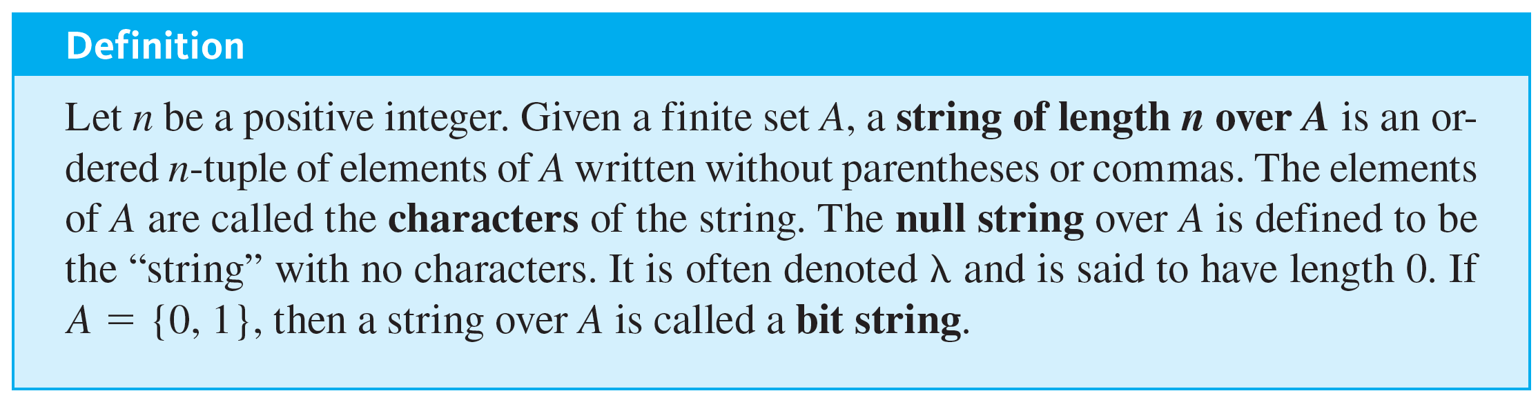
Cartesian Products
Another notation, which is important in both mathematics and computer science, denotes objects called strings.

Slide 41
Example 1.2.8 – Strings
Let A = {a, b}. List all the strings of length 3 over A with at least two characters that are the same.

Slide 42
Example 1.2.8 – Solution
aab, aba, baa, aaa, bba, bab, abb, bbb
In computer programming it is important to distinguish among different kinds of data structures and to respect the notations that are used for them. Similarly in mathematics, it is important to distinguish among, say, {a, b, c}, {{a, b}, c}, (a, b, c), (a, (b, c)), abc, and so forth, because these are all significantly different objects.

